Slide 1
Chapter 1: Introduction

Slide 2
Outline
Basic concepts
The Need for Databases
Data Models
Relational Databases
Database Design
Storage Manager
Query Processing
Transaction Manager

Slide 3
Few Important Terminologies
Data : Raw & Isolated facts about an entity or any real life thing.
Information : Processed, meaningful and useable form of data.
Database : Collection of similar / related data.
DBMS : A set of programs / software used to create, manipulate and delete database / database items.

Slide 4
Database Management System (DBMS)
DBMS contains information about a particular enterprise
  Collection of interrelated data
  Set of programs to access the data
  An environment that is both convenient and efficient to use
Database Applications: Examples:
  Banking: transactions
  Airlines: reservations, schedules
  Universities: registration, grades
  Sales: customers, products, purchases
  Online retailers: order tracking, customized recommendations
  Manufacturing: production, inventory, orders, supply chain
  Human resources: employee records, salaries, tax deductions
Databases can be very large.
Databases touch all aspects of our lives

Slide 5
Database System Applications
Enterprise Information:
  Sales – for customer, products &purchase history information
  Accounting – For Payments , reciepts, acc balance etc. information
  HR : information about employees
  Manufacturing : supply chain, tracking orders, inventories of warehouses.
  Online retailers: sales dta, order trackings, recommended lists etc.

Slide 6
Database System Applications (Contd.)
Banking & Finance:
  Banking : customer information, accounts, loans etc.
  Credit card transactions : purchases on card, monthly statement generation etc.
  Loan management : Applications, management, pipelining, approval & EMI manegement etc.
Airline:
  Reservation management :
  Scheduling :
Telecommunication:
  Call records management:
  Monthly bill generation etc.

Slide 7
University Database Example
Application program examples
  Add new students, instructors, and courses
  Register students for courses, and generate class rosters
  Assign grades to students, compute grade point averages (GPA) and generate transcripts
In the early days, database applications were built directly on top of file systems

Slide 8
Drawbacks of using file systems to store data
Data redundancy and inconsistency
  Multiple file formats, duplication of information in different files
Difficulty in accessing data
  Need to write a new program to carry out each new task
Data isolation
  Multiple files and formats
Integrity problems
  Integrity constraints (e.g., account balance > 0) become “buried” in program code rather than being stated explicitly
  Hard to add new constraints or change existing ones

Slide 9
Drawbacks of using file systems to store data (Cont.)
Atomicity of updates
  Failures may leave database in an inconsistent state with partial updates carried out
  Example: Transfer of funds from one account to another should either complete or not happen at all
Concurrent access by multiple users
  Concurrent access needed for performance
  Uncontrolled concurrent accesses can lead to inconsistencies
    Example: Two people reading a balance (say 100) and updating it by withdrawing money (say 50 each) at the same time
Security problems
  Hard to provide user access to some, but not all, data
Database systems offer solutions to all the above problems

Slide 10
Levels of Abstraction
Physical level: describes how a record (e.g., instructor) is stored.
Logical level: describes data stored in database, and the relationships among the data.
  type instructor = record
  ID : string;
  name : string;
  dept_name : string;
  salary : integer;
        end;
View level: application programs hide details of data types. Views can also hide information (such as an employee’s salary) for security purposes.

Slide 11

View of Data
An architecture for a database system

Slide 12
Instances and Schemas
Schema : The overall database structure in which data is to be stored
Instance : The collection of information stored at a particular moment of time
--The data stored in database at a particular moment of time is called instance of database. Database schema defines the variable declarations in tables that belong to a particular database; the value of these variables at a moment of time is called the instance of that database.

Slide 13
Instances and Schemas (Contd.)
Similar to types and variables in programming languages
Logical Schema – the overall logical structure of the database
  Example: The database consists of information about a set of customers and accounts in a bank and the relationship between them
    Analogous to type information of a variable in a program
Physical schema– the overall physical structure of the database
Instance – the actual content of the database at a particular point in time
  Analogous to the value of a variable
Physical Data Independence – the ability to modify the physical schema without changing the logical schema
  Applications depend on the logical schema
  In general, the interfaces between the various levels and components should be well defined so that changes in some parts do not seriously influence others.

Slide 14
Data Models
A collection of tools for describing
  Data
  Data relationships
  Data semantics
  Data constraints
Relational model
Entity-Relationship data model (mainly for database design)
Object-based data models (Object-oriented and Object-relational)
Semistructured data model (XML)
Other older models:
  Network model
  Hierarchical model

Slide 15
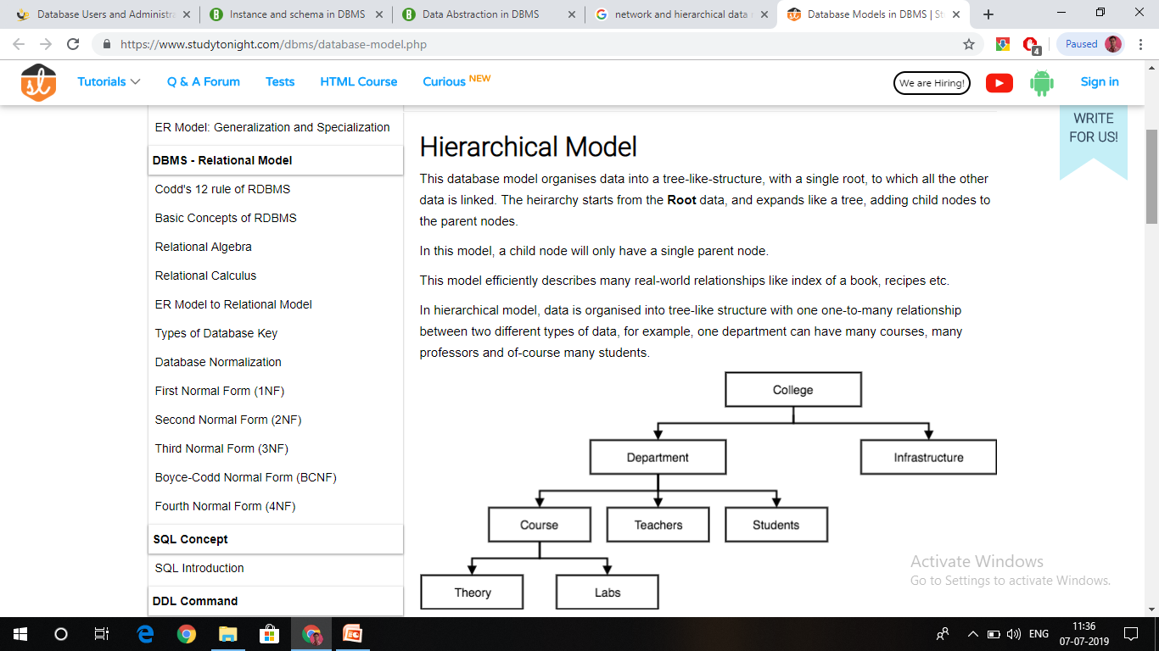

Slide 16
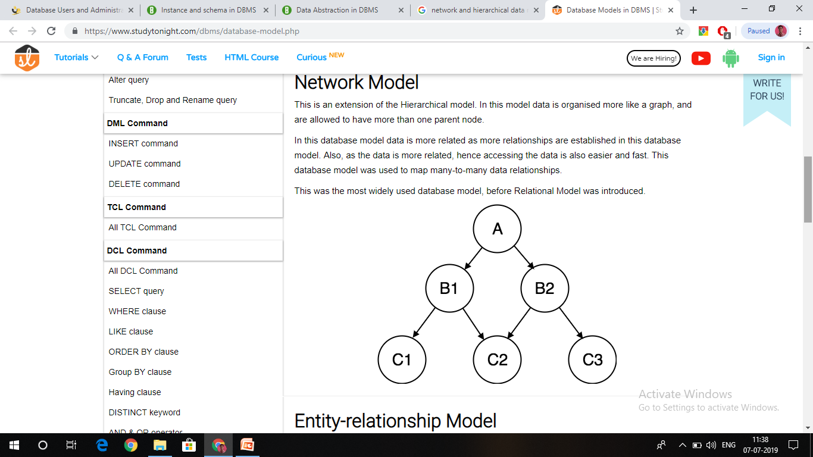

Slide 17
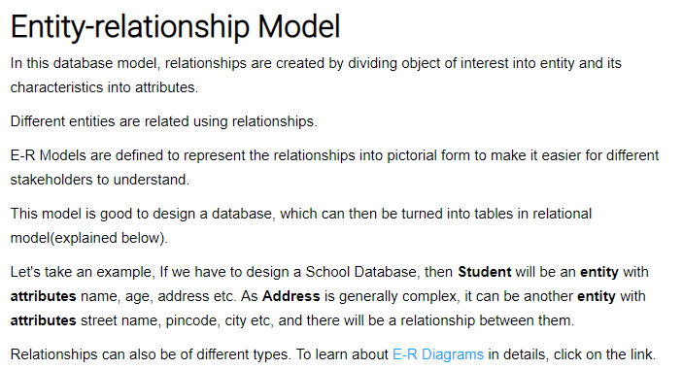
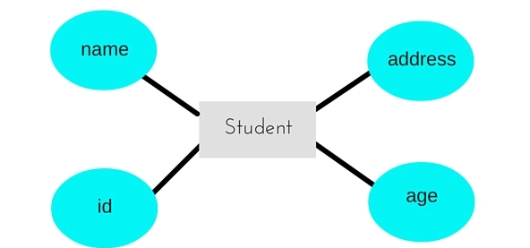

Slide 18
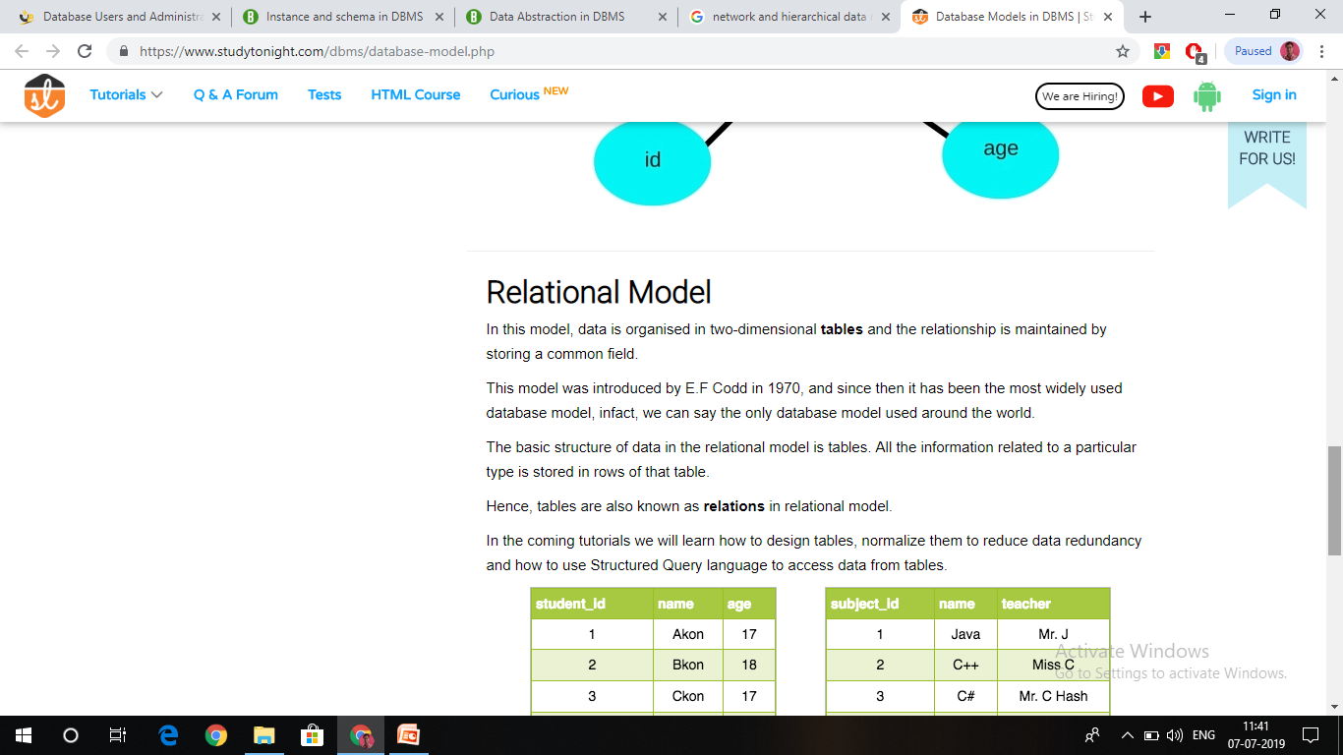

Slide 19

Relational Model
All the data is stored in various tables.
Example of tabular data in the relational model
Columns
Rows

Slide 20
A Sample Relational Database

Slide 21
Data Definition Language (DDL)
Specification notation for defining the database schema
  Example: create table instructor (
  ID char(5),
  name varchar(20),
  dept_name varchar(20),
  salary numeric(8,2));
DDL compiler generates a set of table templates stored in a data dictionary
Data dictionary contains metadata (i.e., data about data)
  Database schema
  Integrity constraints
    Primary key (ID uniquely identifies instructors)
  Authorization
    Who can access what

Slide 22
Data Manipulation Language (DML)
Language for accessing and manipulating the data organized by the appropriate data model
  DML also known as query language
Two classes of languages
  Pure – used for proving properties about computational power and for optimization
    Relational Algebra
    Tuple relational calculus
    Domain relational calculus
  Commercial – used in commercial systems
    SQL is the most widely used commercial language

Slide 23
Database Design
The process of designing the general structure of the database:
Logical Design – Deciding on the database schema. Database design requires that we find a “good” collection of relation schemas.
  Business decision – What attributes should we record in the database?
  Computer Science decision – What relation schemas should we have and how should the attributes be distributed among the various relation schemas?
Physical Design – Deciding on the physical layout of the database

Slide 24

Database Design (Cont.)
Is there any problem with this relation?

Slide 25
Design Approaches
Need to come up with a methodology to ensure that each of the relations in the database is “good”
Two ways of doing so:
  Entity Relationship Model
    Models an enterprise as a collection of entities and relationships
    Represented diagrammatically by an entity-relationship diagram:
  Normalization Theory (Chapter 8)
    Formalize what designs are bad, and test for them
    Eliminating redundancy

Slide 26
Object-Relational Data Models
Relational model: flat, “atomic” values
Object Relational Data Models
  Extend the relational data model by including object orientation and constructs to deal with added data types.
  Allow attributes of tuples to have complex types, including non-atomic values such as nested relations.
  Preserve relational foundations, in particular the declarative access to data, while extending modeling power.
  Provide upward compatibility with existing relational languages.

Slide 27
XML: Extensible Markup Language
Defined by the WWW Consortium (W3C)
Originally intended as a document markup language not a database language
The ability to specify new tags, and to create nested tag structures made XML a great way to exchange data, not just documents
XML has become the basis for all new generation data interchange formats
A wide variety of tools is available for parsing, browsing and querying XML documents/data

Slide 28
What is XML?
XML stands for eXtensible Markup Language
XML is a markup language much like HTML
XML was designed to store and transport data
XML was designed to be self-descriptive
XML is a W3C Recommendation
XML Does Not DO Anything !!
Maybe it is a little hard to understand, but XML does not DO anything.
This note is a note to Tove from Jani, stored as XML:
<note>
<to>Tove</to>
<from>Jani</from>
<heading>Reminder</heading>
<body>Don't forget me this weekend!</body>
</note>
The XML above is quite self-descriptive:
It has sender information.
It has receiver information
It has a heading
It has a message body.
But still, the XML above does not DO anything.
XML is just information wrapped in tags.

Slide 29
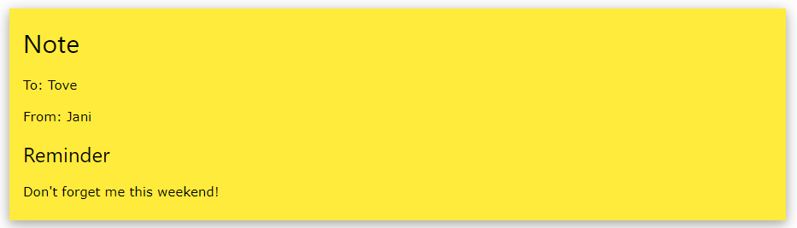
Few explanations of XML
Output of the previous XML using any server connection possible:
The Difference Between XML and HTML
XML and HTML were designed with different goals:
XML was designed to carry data - with focus on what data is
HTML was designed to display data - with focus on how data looks
XML tags are not predefined like HTML tags are
XML Does Not Use Predefined Tags
The XML language has no predefined tags.
The tags in the example above (like <to> and <from>) are not defined in any XML standard. These tags are "invented" by the author of the XML document.
HTML works with predefined tags like <p>, <h1>, <table>, etc.
With XML, the author must define both the tags and the document structure.

Slide 30
Database Engine
Storage manager
Query processing
Transaction manager

Slide 31
Storage Management
Storage manager is a program module that provides the interface between the low-level data stored in the database and the application programs and queries submitted to the system.
The storage manager is responsible to the following tasks:
  Interaction with the OS file manager
  Efficient storing, retrieving and updating of data
Issues:
  Storage access
  File organization
  Indexing and hashing

Slide 32

Query Processing
1. Parsing and translation
2. Optimization
3. Evaluation

Slide 33
Query Processing (Cont.)
Alternative ways of evaluating a given query
  Equivalent expressions
  Different algorithms for each operation
Cost difference between a good and a bad way of evaluating a query can be enormous
Need to estimate the cost of operations
  Depends critically on statistical information about relations which the database must maintain
  Need to estimate statistics for intermediate results to compute cost of complex expressions

Slide 34
Transaction Management
What if the system fails?
What if more than one user is concurrently updating the same data?
A transaction is a collection of operations that performs a single logical function in a database application
Transaction-management component ensures that the database remains in a consistent (correct) state despite system failures (e.g., power failures and operating system crashes) and transaction failures.
Concurrency-control manager controls the interaction among the concurrent transactions, to ensure the consistency of the database.

Slide 35

Database Users and Administrators
Database

Slide 36

Database System Internals

Slide 37
Database Architecture
The architecture of a database systems is greatly influenced by
the underlying computer system on which the database is running:
Centralized
Client-server
Parallel (multi-processor)
Distributed

Slide 38
History of Database Systems
1950s and early 1960s:
  Data processing using magnetic tapes for storage
    Tapes provided only sequential access
  Punched cards for input
Late 1960s and 1970s:
  Hard disks allowed direct access to data
  Network and hierarchical data models in widespread use
  Ted Codd defines the relational data model
    Would win the ACM Turing Award for this work
    IBM Research begins System R prototype
    UC Berkeley begins Ingres prototype
  High-performance (for the era) transaction processing

Slide 39
History (cont.)
1980s:
  Research relational prototypes evolve into commercial systems
    SQL becomes industrial standard
  Parallel and distributed database systems
  Object-oriented database systems
1990s:
  Large decision support and data-mining applications
  Large multi-terabyte data warehouses
  Emergence of Web commerce
Early 2000s:
  XML and XQuery standards
  Automated database administration
Later 2000s:
  Giant data storage systems
    Google BigTable, Yahoo PNuts, Amazon, ..

Slide 40
End of Chapter 1

